Slide 1
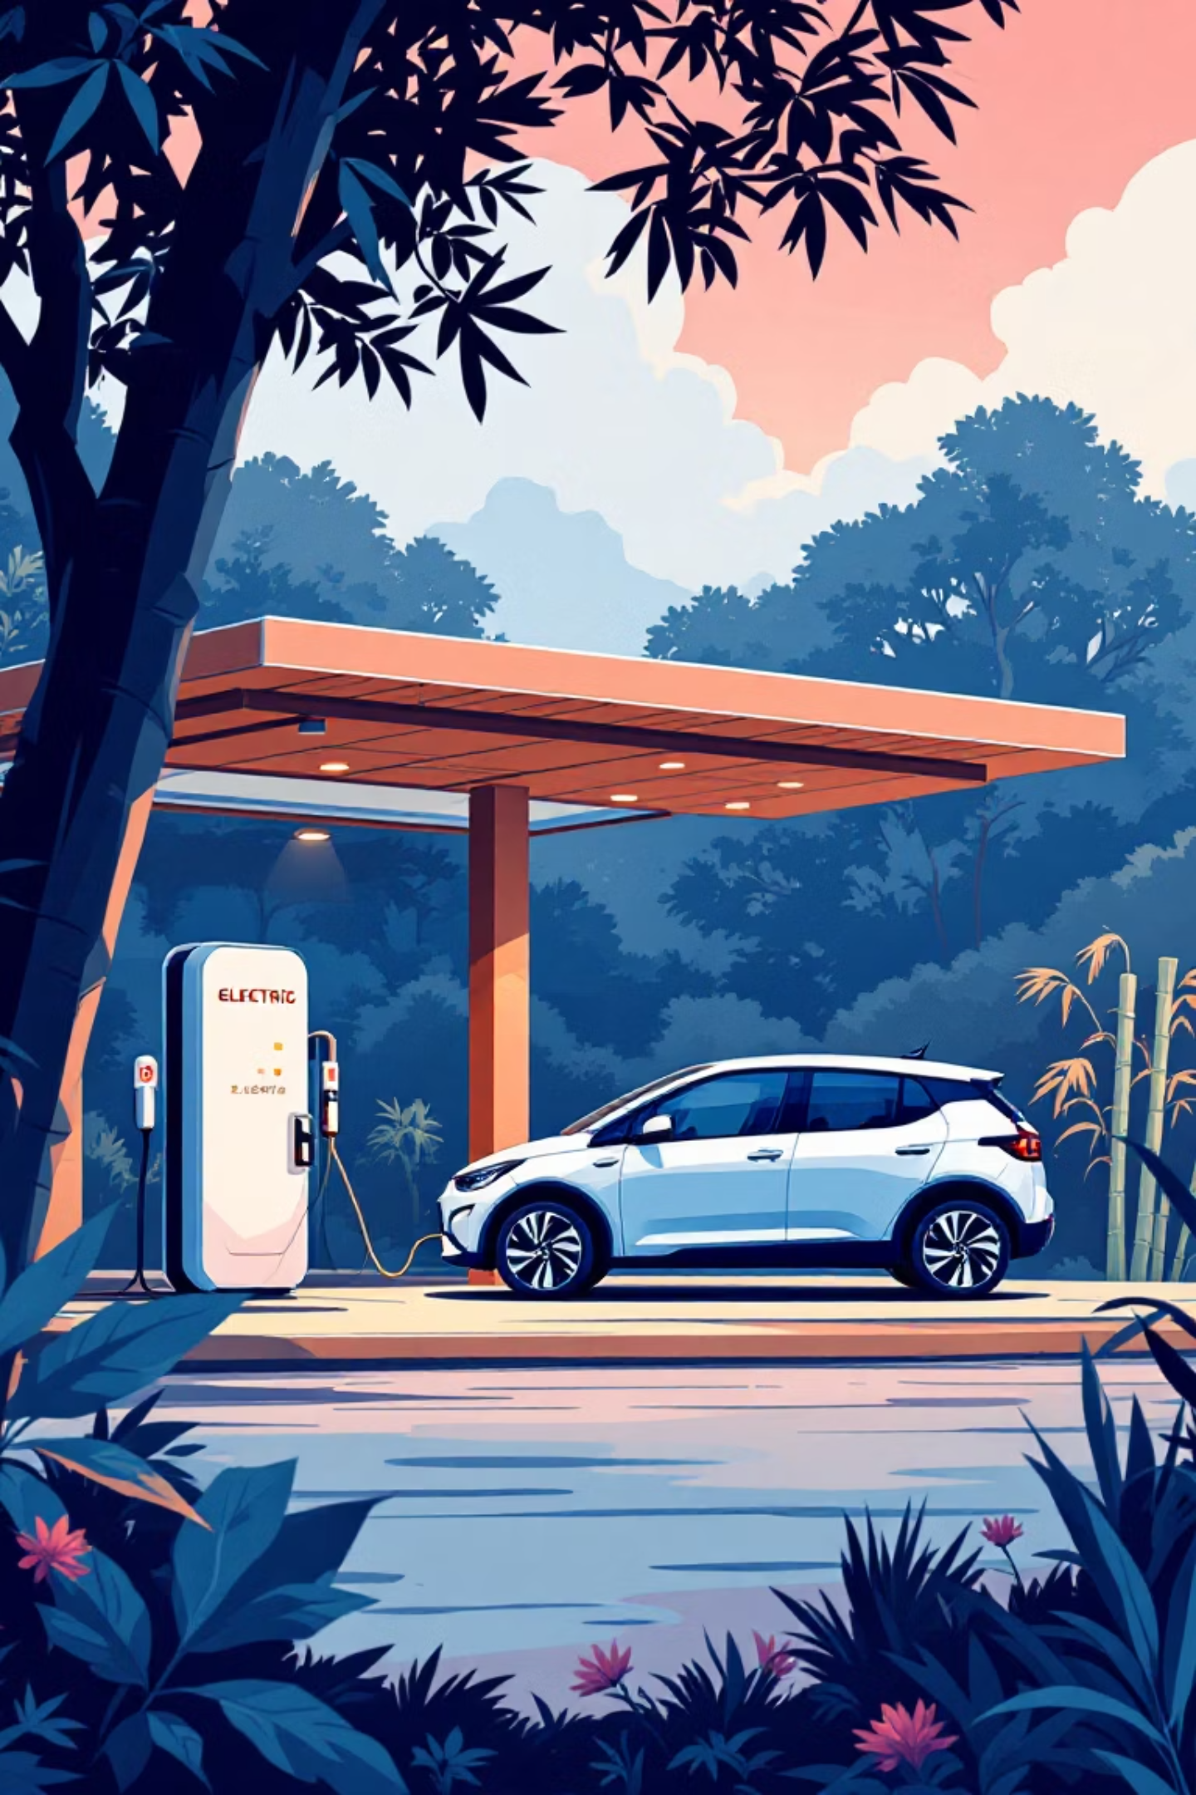
Electric Vehicle (EV) Sales Analysis & Prediction in India
Data-driven insights & predictive modelling for India's EV revolution (2014–2024)

Slide 2

Project Overview
Objective
Dataset
Analyse EV sales trends across India and develop machine learning models to predict future sales patterns for strategic planning.
Comprehensive analysis of ~96K rows covering 11 key variables including temporal, geographical, and vehicle classification data.
Methodology
Advanced data preprocessing, feature engineering, and Random Forest Regression for accurate sales forecasting and trend analysis.

Slide 3

Data Engineering & Model Preparation
01
02
Data Cleaning
Feature Engineering
Systematically handled missing values and outliers to ensure data quality and model reliability across all 96K records.
Extracted temporal features (year, month, seasonality) and created categorical encodings for geographic and vehicle classifications.
03
Model Training
Implemented train-test split methodology with Random Forest Regression for robust predictive modelling and validation.

Slide 4
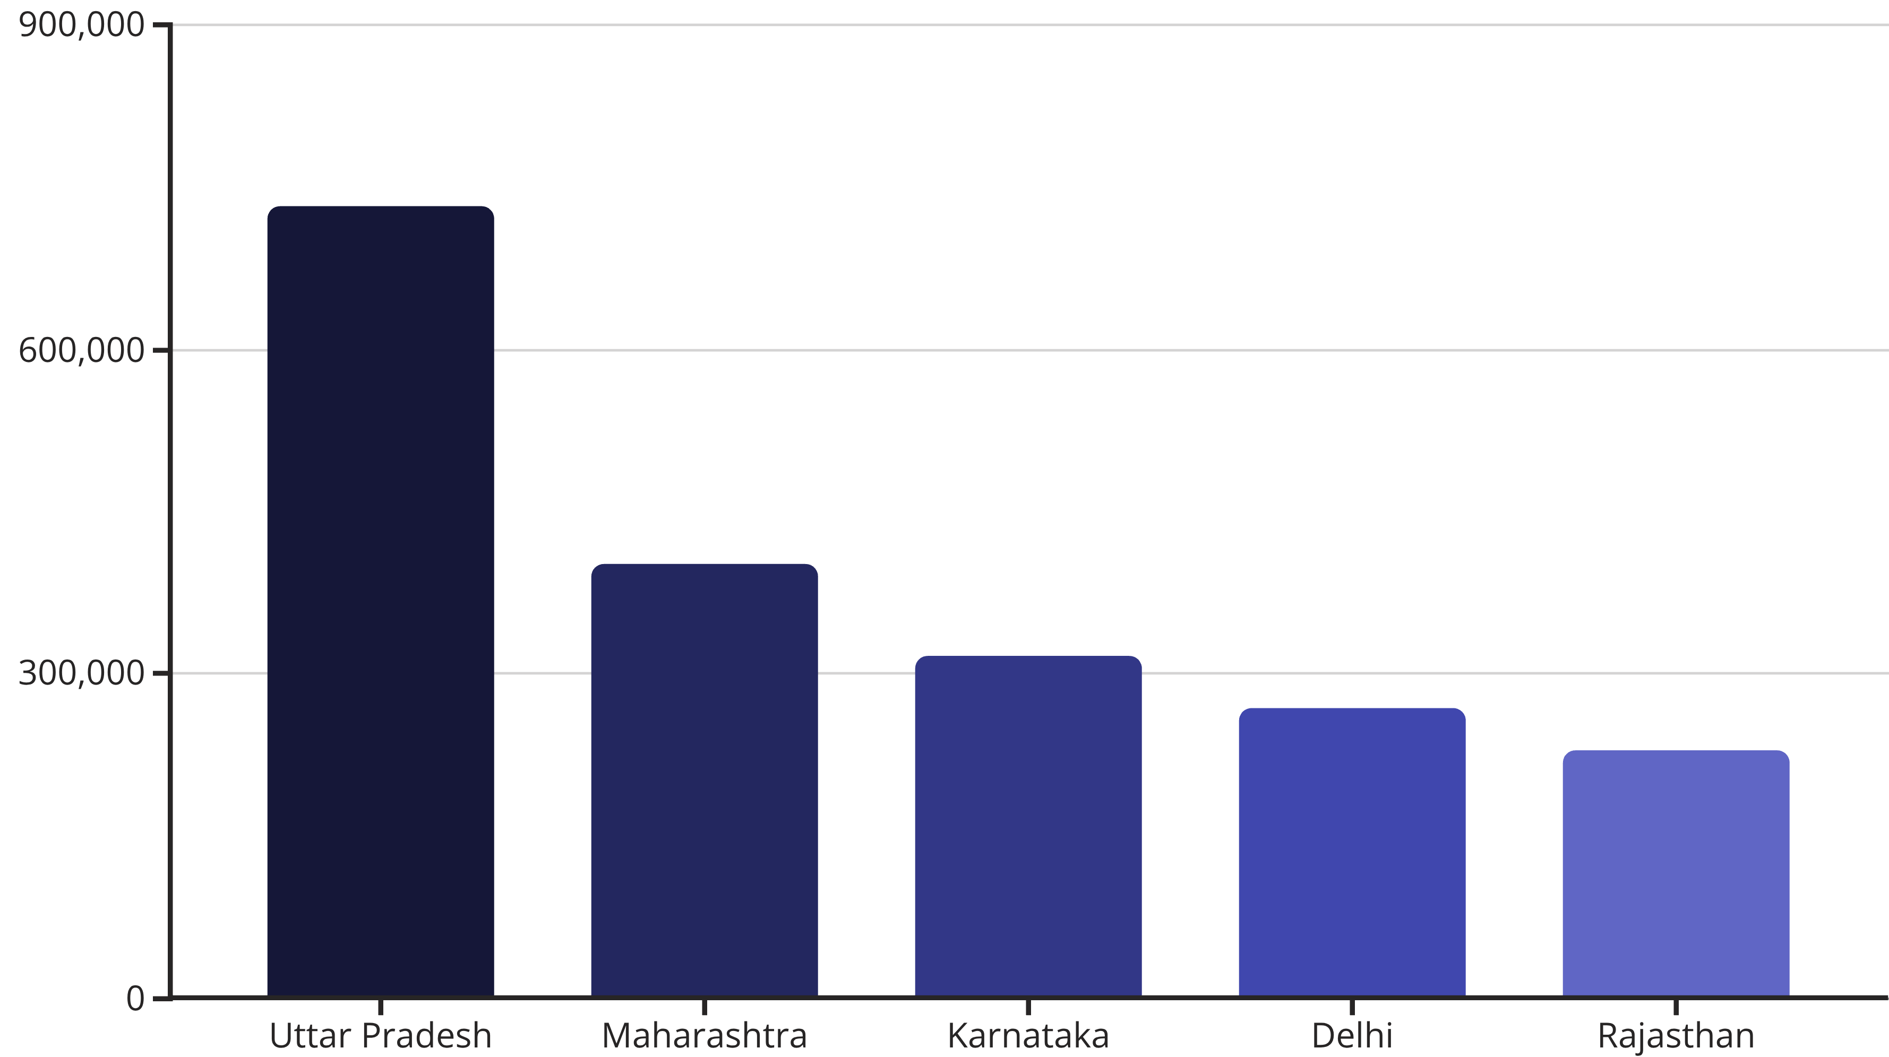
Leading States Driving EV Adoption
Uttar Pradesh leads with over 730K EV sales, followed by Maharashtra and Karnataka. These five states represent the primary growth engines for India's electric mobility transformation.

Slide 5
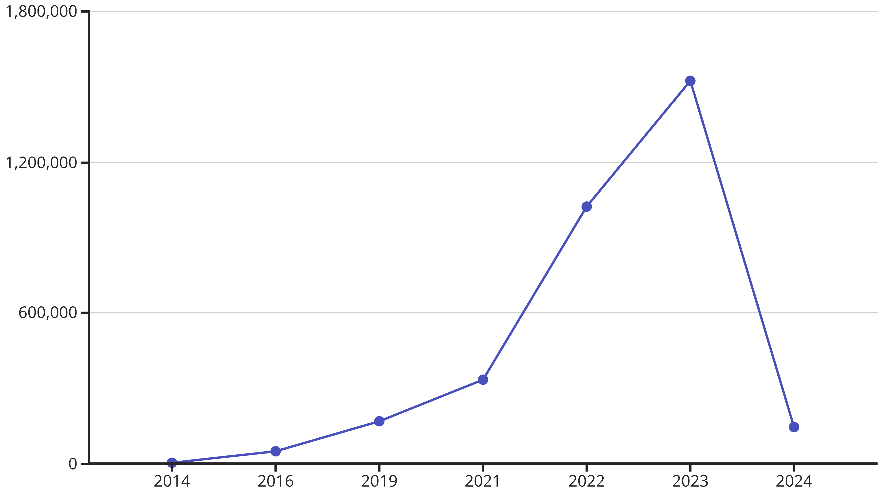
Explosive Growth Trajectory
Peak year 2023 witnessed unprecedented growth with 1.5M+ sales. The exponential rise post-2020 reflects successful policy interventions and increased environmental awareness.

Slide 6

Vehicle Segment Distribution
By Vehicle Class
By Category
1.8M
1.6M
2-Wheelers
3-Wheelers
Dominant segment driving mass adoption
Commercial applications leading growth
M-Cycle/Scooter
E-Rickshaw Passenger
Motor Car
150K
E-Rickshaw Goods
4-Wheelers
Emerging premium segment

Slide 7
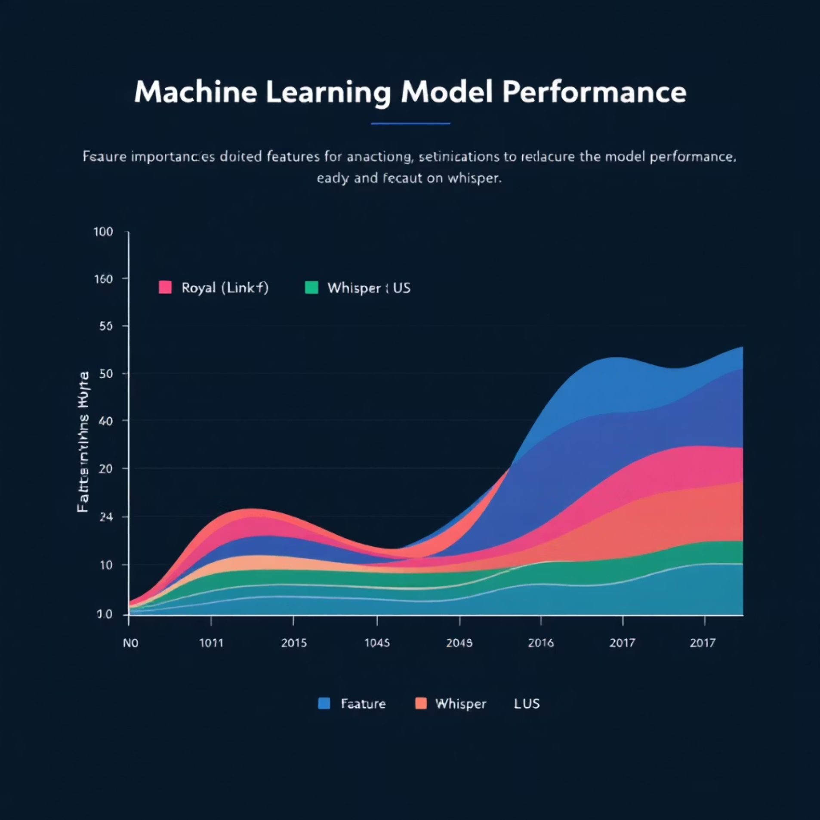
Machine Learning Model Performance
Model Architecture
Feature Importance Rankings
Random Forest Regressor with optimised hyperparameters for robust sales prediction and trend forecasting.
Year: Primary driver of sales trends
State: Geographic market influence
Vehicle Class: Category-specific demand patterns
Month: Seasonal purchasing behaviour
Performance Metrics
Vehicle Type: Consumer preference indicators
Achieved strong predictive accuracy with low RMSE, demonstrating reliable forecasting capabilities for strategic planning.

Slide 8




Strategic Insights & Recommendations
Market Focus
Segment Strategy
Predictive Planning
Prioritise infrastructure development and marketing initiatives in Uttar Pradesh, Maharashtra, and Karnataka for maximum impact.
Continue supporting 2-wheeler and 3-wheeler adoption whilst developing targeted policies to accelerate 4-wheeler penetration.
Leverage machine learning models for demand forecasting, supply chain optimisation, and strategic resource allocation.

Slide 9
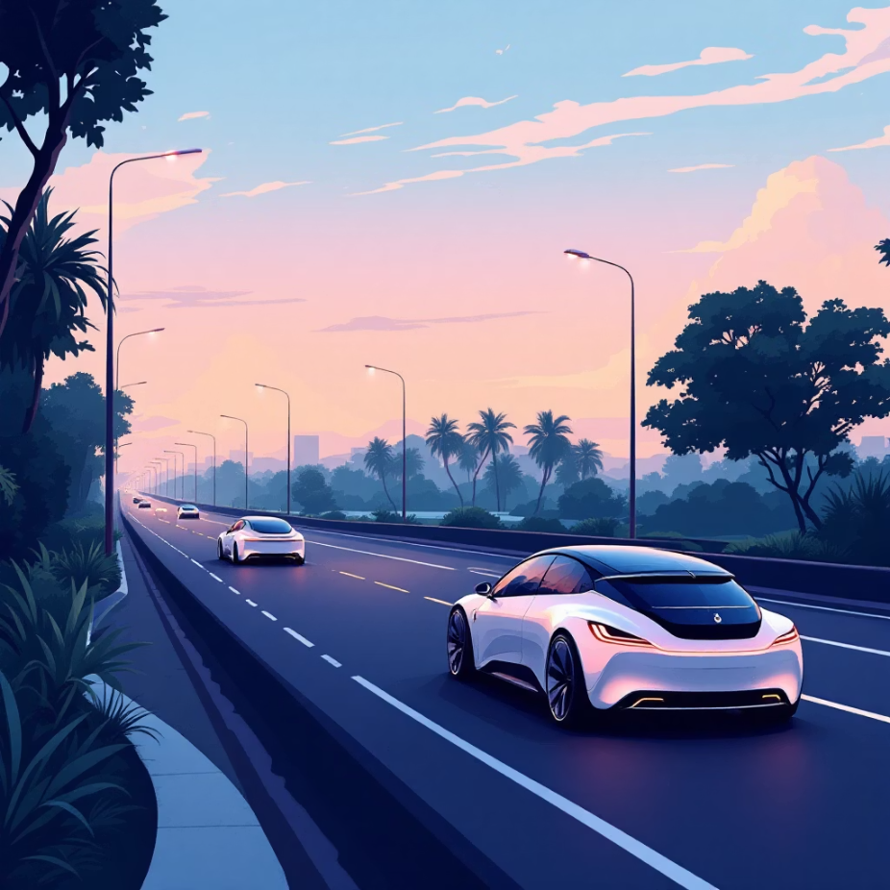
Future of Electric Mobility in India
India's EV sector is experiencing exponential growth with tremendous potential for continued expansion through data-driven decision making.
Market Transformation
Strategic Applications
From 2.4K sales in 2014 to 1.5M+ in 2023, demonstrating unprecedented market evolution and consumer acceptance.
Predictive analytics enables policymakers and manufacturers to optimise strategies, infrastructure deployment, and market positioning.
Future Enhancement
Integration of charging infrastructure data, fuel price dynamics, and subsidy impact analysis will further improve model accuracy.

